Slide 1
Evolving your Power BI Architecture using Dataflows and Shared Datasets
Ben Watt
www.datalineo.com

Slide 2

Agenda
History lesson: Microsoft BI Enterprise Architecture
Power BI Architecture. Simple.
Dataflows
Shared Datasets
Power BI Architecture. Evolved.
Link to slides

Slide 3





At your Service!
Managing Director at Datalineo
Microsoft MVP Data Platform
Power BI: SQL/Azure/Power Platform
Dublin PUG leader
Event Co-Ordinator:
Data Ceili
Power Platform WT
Ben Watt
ben@datalineo.com
@benrebooted
linkedin.com/in/benonline

Slide 4
General Content Slides
The Subtitle of the section break

Slide 5







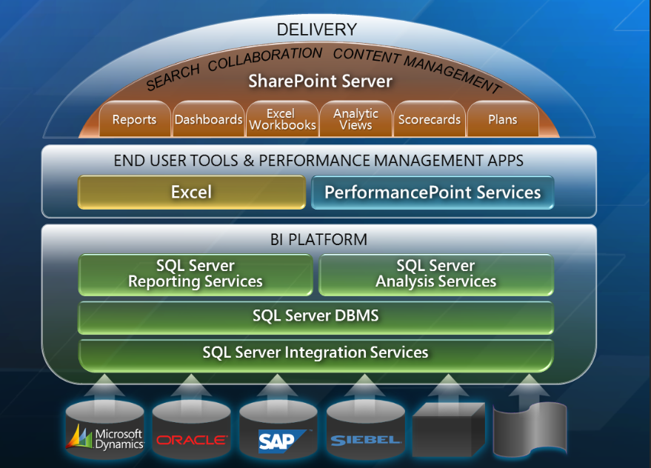
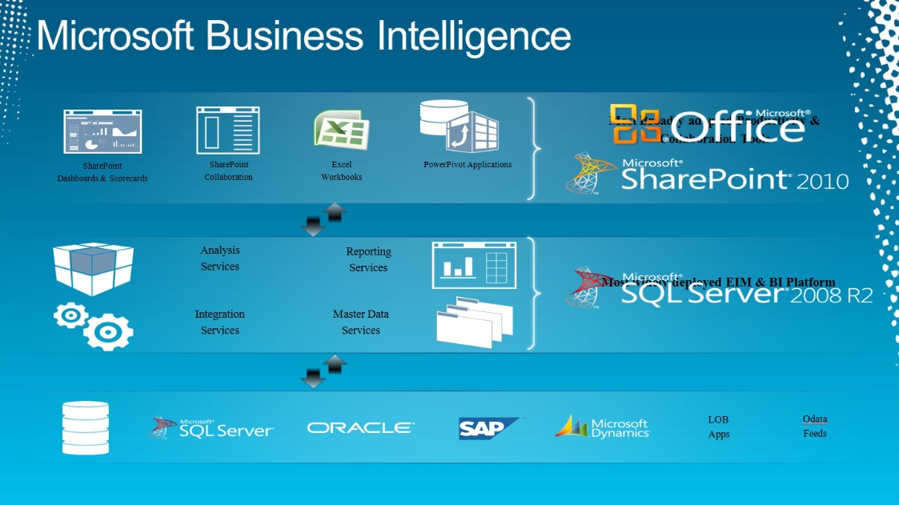
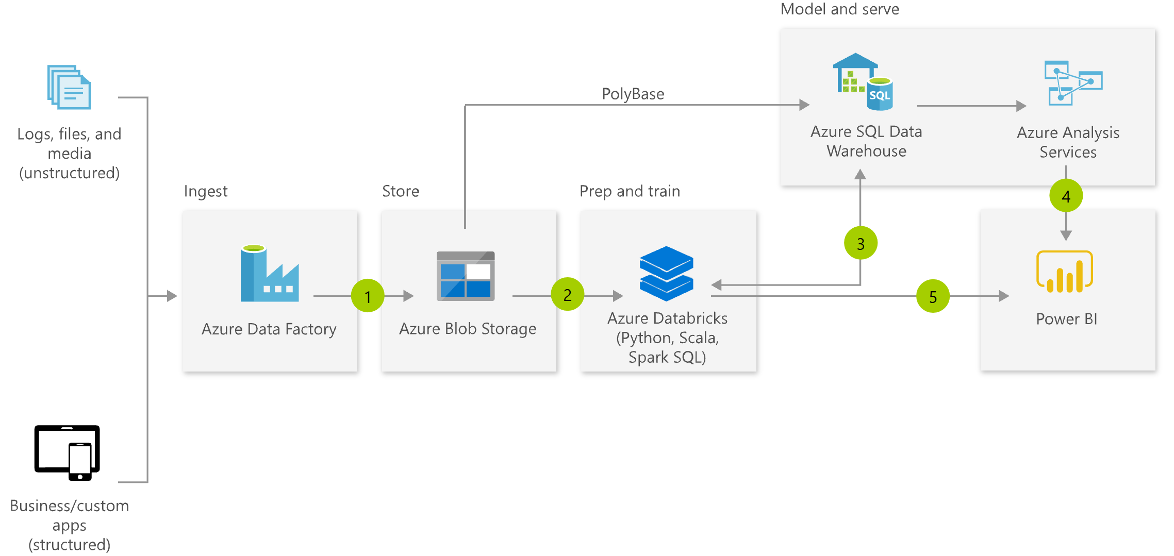
History Lesson: Microsoft Enterprise BI
Get
Store
Semantic
Model
Data Viz
Typical BI Solution
SQL Server/On-Prem
SSIS
DWH
SSAS
SSRS++
Tools & Technology
Azure/Cloud
ADF
SQL DB
AzureAS
Power BI
Solution Architecture through the ages

Slide 6


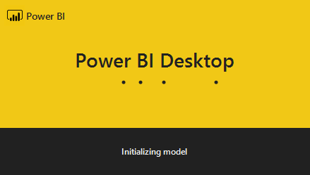

Power BI Solution (simple version)
Store
Semantic
Model
Data Viz
Get
Power BI
Power Query
PBI SSAS
PBI Viz
Power BI Service
Workspaces
One single PBIX file.
Includes:
Get, Model, Data Viz
Publish to a single workspace
Schedule refresh
Schedule
Finance
.PBIX
Sales
Works for..
Small number of report pages
Consistent audience
Minimal development

Slide 7

Let’s scale up!
Shared Datasets and Dataflows.

Slide 8
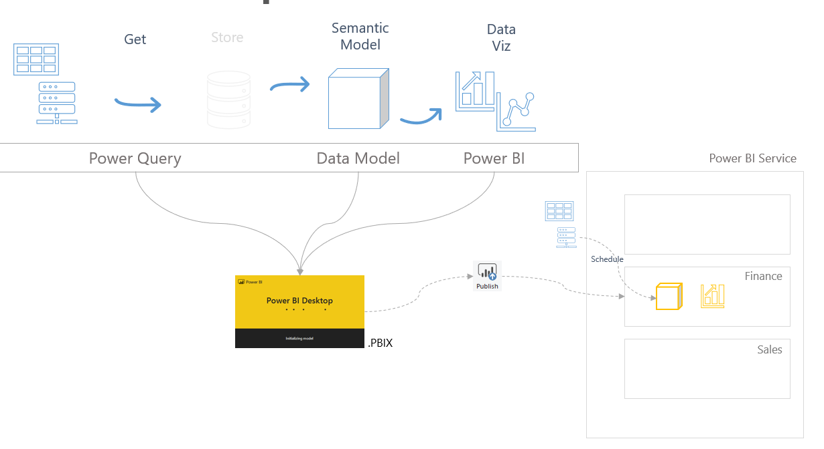
Features to help you scale. Part I - Dataflows
Decouples the data acquisition from the .PBIX
Makes the data available for multiple datasets
Acts like the ETL and DWH of Enterprise BI
Separates the scheduling of data acquisition & model refresh
Dataflows
Considerations
Centralises common tables/entities
E.g. a single Calendar table
Data is stored in Azure Data Lake Gen2 as CDM compliant folders.
10GB (Pro), 100TB (P1), or BYO
Develop in browser
Premium features
Incremental refresh
Parallel refresh
Linked/Computed Entities
AI Insights

Slide 9
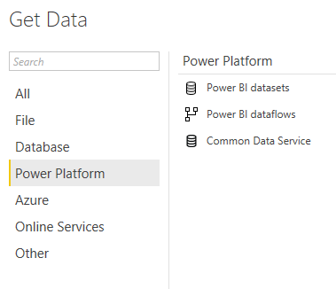



Features to help you scale. Part II – Shared Datasets
Decouples the Data Model from the Data Viz
Simplifies deployment
Removes workspace barriers
Certify and Promote Datasets
Shared Datasets
Considerations
Use Promoted or Certified Datasets
One shared dataset per PBIX: live connection
Security
Apps
Workspaces
Row Level
Build Access
Power BI Service
Data Warehouse
Schedule
Live
connection
Finance
Sales

Slide 10



Power BI solution (evolved)
Typical BI Solution
Store
Semantic
Model
Data Viz
Get
SQL Server/On-Prem
SSIS
RDBMS
SSAS
SSRS
Tools & Technology
Azure/Cloud
ADF
SQL DB
AzureAS
Power BI
Shared Data Model
Live
Connection Reports
Dataflows
Power BI Evolved
Power Query
CDM
PBI SSAS
PBI Viz
Dataflows

Slide 11
Benefits Summary
Shared Datasets
Dataflows
Separation of Data Model & Data Viz
Better organisation of multiple reports/pages
Simpler deployment process
Separation of user groups by workspace
Flagging of Certified or Promoted Data Models
Data Analysts focus on Analysis & Reports, BI Developers focus on platform
Separation of Data Acquisition
Reusability of logic
Released pressure on source data
Improved refresh failure issues

Slide 12

Slides, etc:
https://github.com/datalineo/sessions
Hit me up…
EMAIL
WEBSITE
TWITTER
ben@datalineo.com
www.datalineo.com
@benrebooted

